Slide 2
Learning Objectives (1 of 2)
Describe the makeup of the Internet and the World Wide Web
Discuss navigational tools, search engines, and directories
Describe common Internet services
Summarize widely used Web applications
Explain the purpose of intranets

Slide 3
Learning Objectives (2 of 2)
Explain the purpose of extranets
Summarize the trends of the Web 2.0 and Web 3.0 eras and Internet2
Describe the Internet of Everything

Slide 4
The Internet and the World Wide Web (1 of 4)
Internet: worldwide collection of millions of computers and networks of all sizes
Network of networks
Started in 1969 as a project by the U.S. Department of Defense called Advanced Research Projects Agency Network (ARPANET)
Evolved into the national Science Foundation Network (NSFNET) in 1987

Slide 5
The Internet and the World Wide Web (2 of 4)
Internet backbone: foundation network linked with fiber-optic cables that can support high bandwidth
Made up of many interconnected government, academic, commercial, and other high-capacity data routers
Private companies operate their own Internet backbones that interconnect at network access points (NAPs)

Slide 6
The Internet and the World Wide Web (3 of 4)
The World Wide Web (i.e., WWW or the Web) changed the Internet in 1989
Introduced a graphical interface to text-based Internet
Organizes information by using hypermedia
Documents include embedded references to audio, text, images, video, and other documents
Hypertext: embedded references in hypermedia documents

Slide 7
The Internet and the World Wide Web (4 of 4)
Server or Web server
Any computer that stores hypermedia documents and makes them available to other computers on the Internet
Exciting feature of the Web
Hypermedia can be stored anywhere in the world, so users can jump from a site in the U.S. to a site in France in a few milliseconds

Slide 8
The Domain Name System (1 of 2)
Domain names
Unique identifiers of computer or network addresses on the Internet
Internet Protocol (IP) address
Assigned by the Internet Corporation for Assigned Names and Numbers (ICANN)
Domain Name System (DNS)
Protocol that converts domain names into IP addresses when information is transferred from one network to another

Slide 9
The Domain Name System (2 of 2)
Domain names are used to identify a Web page in uniform resource locators (URLs)
Refer to the address of a document or site
Have a suffix that indicates the top-level domain (TLD)
Denotes the type of organization or country the address specifies
Divided: top-level domains (gTLDs) and country code top-level domains (ccTLDs)

Slide 10
7.1 Generic Top-Level Domains
gLTD | Purpose
.com | Commercial organizations (such as Microsoft)
.edu | Educational institutions (such as California State University)
.int | International organizations (such as the United Nations)
.mil | U.S. military organizations (such as the U.S. Army)
.gov | U.S. government organizations (such as the Internal Revenue Service)
.net | Backbone, regional, and commercial networks (e.g., the National Science Foundation’s Internet Network Information Center)
.org | Other organizations, such as research and nonprofit organizations (e.g., the Internet Town Hall)

Slide 11
Types of Internet Connections
Connection methods
Dial-up modems
Cable modems
Digital Subscriber Line (DSL)
Symmetric DSL (SDSL)
Asymmetric DSL (ADSL)
Very High-Speed DSL (VDSL)

Slide 12
Navigational Tools, Search Engines, and Directories
Navigational tools
Used to travel from Web site to Web site
Search engines
Enable users to retrieve information from the Internet by using keywords
Directories
Indexes of information based on keywords embedded in documents; allow search engines to find required information

Slide 13
Navigational Tools
Graphical Web browsers: Microsoft Internet Explorer (IE), Mozilla Firefox, Google Chrome, Apple Safari, and Opera
Consist of menu options
Viewing browsing history
Bookmarking favorite Web sites
Setting viewing preferences
Navigation buttons

Slide 14
Search Engines and Directories (1 of 4)
Crawling the Web
Search engines use software called crawlers, spiders, and bots to search the Web continuously for new data
Gathered data is sent back to the search engine’s data center to ensure that it has the most current information on the Web

Slide 15
Search Engines and Directories (2 of 4)
Indexing
Housed at server farms, search engines use keywords to index data coming in from crawlers
Each keyword has an index entry that is linked to all Web pages containing that keyword

Slide 16
Search Engines and Directories (3 of 4)
Searching
Search engine:
Uses the index created during the indexing step to look up the search term
Identifies all Web pages linked to the term if the term exists in the index
Varies in intelligence

Slide 17
Search Engines and Directories (4 of 4)
Automated or crawler-based directory
Creates indexes of search terms and collects these terms automatically by using crawlers
Human-powered directory
Requires keywords to be manually submitted for a Web page to be listed in a search engine’s results
Relies on users to supply data

Slide 18
Internet Services
Made possible by the TCP suite of protocols
TCP/IP provides useful e-mail protocols
Simple Message Transfer Protocol (SMTP)
Post Office Protocol (POP)
Popular services
E-mail, newsgroups, discussion groups, Internet Relay Chat (IRC), instant messaging, and Internet telephony

Slide 19
E-Mail
Widely used services on the Internet
Main types
Web-based e-mail
Client-based e-mail
E-mail programs
Folders for organizing e-mails
Address book and distribution groups
Spell checkers and delivery notifications

Slide 20
Newsgroups and Discussion Groups
Discussion groups
Formed for people to exchange opinions and ideas on a specific topic
Group members post messages or articles that others in the group can read
Newsgroups
General in nature and can cover any topic
Allow people to get together for fun or for business purposes

Slide 21
Instant Messaging (1 of 2)
Internet Relay Chat (IRC)
Enables users in chat rooms to exchange text messages with people in other locations in real time
Instant messaging (IM)
Service for communicating with others via a private “chat room” on the Internet
Applications: Windows Messenger, Yahoo! Messenger, and Google Chat

Slide 22
Instant Messaging (2 of 2)
Snapchat
New type of messaging offered by a mobile app
Users combine pictures, videos, text, and drawings into “Snaps” that are sent to other users
Snaps self-destruct in a matter of seconds and can be undeleted and brought back to life

Slide 23
Internet Telephony (1 of 2)
Using the Internet to exchange spoken conversations
Voice over Internet Protocol (VoIP)
Requires a high-speed Internet connection and a microphone or headset
Used to route traffic starting and ending at conventional public switched telephone network (PSTN) phones

Slide 24
Internet Telephony (2 of 2)
Drawback
Lack of call quality
Advantages
Absence of busy lines
Receiving voicemails on the computer
Ability to:
Screen callers and forward calls from anywhere in the world
Direct calls to the correct departments and take automated orders

Slide 25
Web Applications
Several service industries use the Internet and its supporting technologies
Offer services and products to a wide range of customers at more competitive prices and with increased convenience

Slide 26
Tourism and Travel
Industry has benefited from e-commerce Web applications
Travel Web sites:
Allow customers to book tickets for plane trips and cruises and make reservations for hotels and rental cars
Examples: Expedia.com, Travel.com, Travelocity.com, Priceline.com, Hotels.com, Yahoo! Travel, and Google.com/flights/

Slide 27
Publishing
Major publishers in the U.S. and Europe have Web sites that offer:
Descriptions of forthcoming books
Sample chapters
Online ordering
Search features
Books that can be read online free for 90 days
Purchase options for e-book versions

Slide 28
Higher Education
University Web sites offer:
Information about departments, programs, faculty, and academic resources
Virtual tours of the campus
Online degree programs
Help colleges and universities facing an enrollment decline
Professional certificate programs

Slide 29
Real Estate (1 of 2)
Real-estate Web sites:
Provide up-to-date listings of homes
Allow buyers to review neighborhoods, schools, and real estate prices
Help customers find realtors and brokerage firms and learn home-buying tips
Provide virtual tours of houses on sale

Slide 30
Real Estate (2 of 2)
Services include:
Appraisals
Neighborhood and school profiles
Financing options
Home-improvement advice
Major real-estate Web sites
Remax, Century 21, Prudential, ERA, and Zillow

Slide 31
Employment
Sites offer comprehensive services to job seekers, including:
Expert advice and tools for managing one's career
Resume assistance, including posting and distributing resumes
Job search tutorials and salary calculators
Announcements of job fairs and career tests

Slide 32
Financial Institutions (1 of 2)
Offer online banking services
Use e-mails to communicate with customers and send account statements and financial reports
Helps reduce the time and costs of communicating via phone

Slide 33
Financial Institutions (2 of 2)
Online banking services
Accessing customer service by e-mail around the clock
Viewing current and old transactions
Online mortgage applications
Interactive tools
Finding loan and credit card information
Paying bills and credit card accounts
Transferring funds and viewing digital copies of checks

Slide 34
Software Distribution
Vendors distribute software, drivers, and patches on the Internet
Fast and easy to download
Large programs cannot be distributed via the Internet
Provides an inexpensive, convenient, and fast way to sell software

Slide 35
Health Care
Web sites store patient records on the Internet
Patient information is accessible from one central location
Have potential problems involving information privacy, accuracy, and currency
Other uses
Telemedicine and telepresence surgery

Slide 36
Politics (1 of 2)
Political candidates use Web sites in campaigns, which are helpful tools for:
Announcing candidates’ platforms
Publicizing voting records
Posting notices of appearances and debates
Raising campaign funds

Slide 37
Politics (2 of 2)
Internet has helped:
Empower voters
Revitalize the democratic process
Provide the possibility of legislators to vote on bills via online systems

Slide 38
Intranets (1 of 2)
Network within an organization
Uses Internet protocols and technologies for collecting, storing, and disseminating useful information that supports business activities
Used by employees for internal purposes
Companies also allow trusted business partners to access their intranets

Slide 39
Intranets (2 of 2)
Use Internet technologies to solve organizational problems that have been solved in the past
Different from a LAN
Set up behind a firewall
Defining and limiting access is important for security reasons

Slide 40
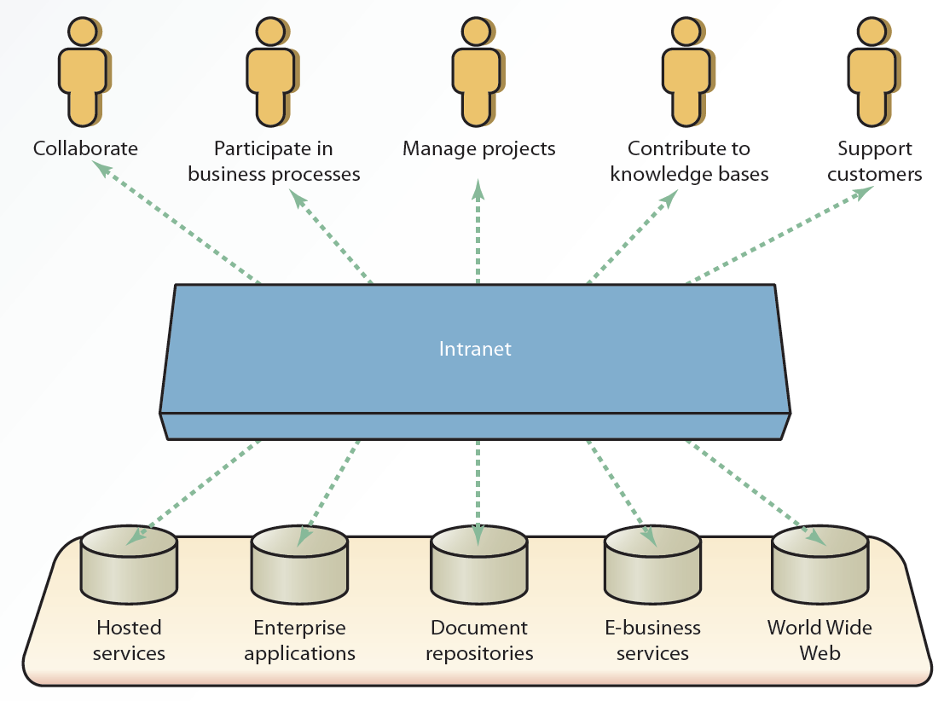
7.3 Simple Intranet Architecture

Slide 41
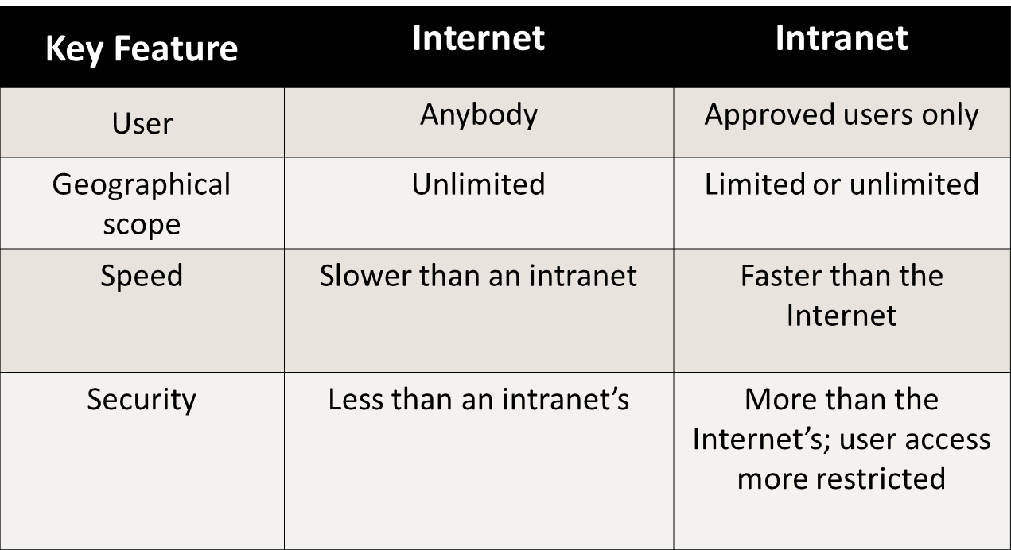
7.2 The Internet vs. Intranets

Slide 42
Applications of an Intranet
Information availability
Human resources management
Sales and marketing
Production and operations
Accounting and finance
Strategy based on events or needs

Slide 43
Extranets (1 of 3)
Secure networks
Uses the Internet and Web technologies to connect intranets of business partners
Facilitates communication between organizations or between consumers
Considered to be a type of interorganizational system (IOS)
Examples: electronic funds transfer (EFT) and electronic data interchange (EDI)

Slide 44
Extranets (2 of 3)
Applications
Timely order-entry processing
Federal Express Tracking System
Allow companies to reduce internetworking costs
Provide a competitive advantage that leads to increased profits
Require a comprehensive security system and management control

Slide 45
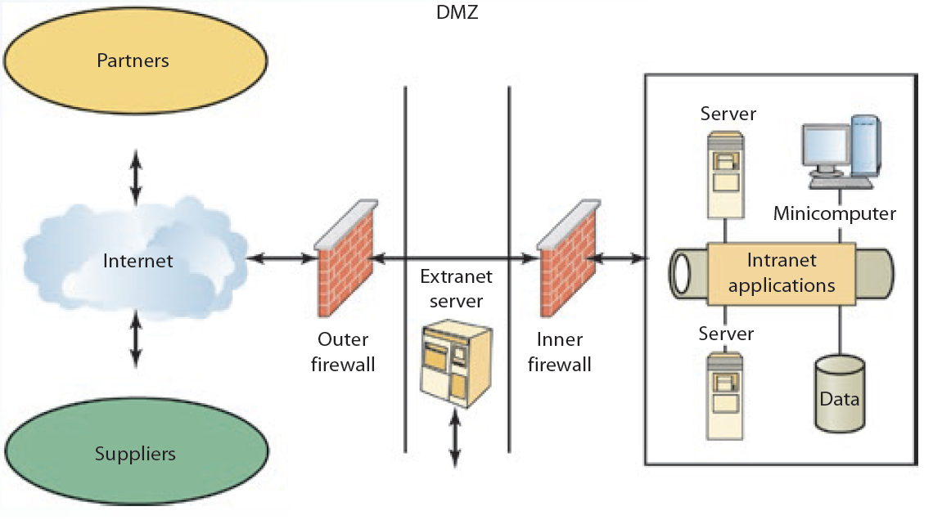
7.4 Simple Extranet Architecture

Slide 46
Extranets (3 of 3)
Advantages
Coordination
Feedback
Consumer satisfaction
Cost reduction
Expedited communication

Slide 47
7.3 Comparisons
 | Internet | Intranet | Extranet
Access | Public | Private | Private
Information | General | Typically confidential | Typically confidential
Users | Everybody | Members of an organization | Groups of closely related companies, users, or organizations

Slide 48
New Trends: The Web 2.0 and Web 3.0 Eras (1 of 3)
Web 2.0
Trend toward Web applications that are more interactive than traditional Web applications
Collaboration or e-collaboration is one of the key components
Main focus: social networking and collaboration

Slide 49
New Trends: The Web 2.0 and Web 3.0 Eras (2 of 3)
Provides personalization that allows users to access the Web more intelligently
Main focus: intelligent Web applications using artificial intelligence technologies
Goal: tailor online requests to users’ specific search patterns, preferences, and needs

Slide 50
New Trends: The Web 2.0 and Web 3.0 Eras (3 of 3)
One part of Web 3.0 could be the semantic Web
Enable computers to understand what they are displaying and communicate more effectively with one another

Slide 51
Blogs
Journal or newsletter that is updated frequently and intended for the general public
Reflect the authors’ personalities and include philosophical reflections and opinions on social or political issues
Microblogs
Newer version of traditional blogs
Enable users to create smaller versions of blog posts

Slide 52
Wikis
Web site that allows users to add, delete, and modify content
Unique because an information user can also be an information provider
Drawback
Content accuracy is affected by allowing anyone to modify the content
Corporate wikis
Include tighter security and access controls

Slide 53
Social Networking Sites
Broad class of Web sites and services
Connect with friends, family, and colleagues online
Meet people with similar interests
Popular social networking sites
Facebook, Twitter, and LinkedIn
Used by companies for customer opinions and advertising

Slide 54
Business Application of Social Networks
Social networks used for promotion
Facebook
Twitter
Pinterest
LinkedIn Groups
YouTube
Yelp, Foursquare, and Level Up

Slide 55
RSS (Really Simple Syndication) Feeds (1 of 2)
Fast, easy way to distribute Web content in Extensible Markup Language (XML) format
Subscription service
Deliver new content selected from Web sites via a feed reader to one convenient spot
Subset of Standard Generalized Markup Language (SGML)

Slide 56
RSS (Really Simple Syndication) Feeds (2 of 2)
Extensible Markup Language (XML)
Flexible method for creating common formats for information
Tags represent the kind of content being posted and transmitted
Prevents confusion by defining data with a context
Designed to improve interoperability and data sharing between different systems

Slide 57
Podcasting
Electronic audio file posted on the Web for users to download to their mobile devices or computers
Consists of a specific URL and is defined with an XML item tag
Collected by an aggregator
iTunes or iPodder
Users can subscribe to a podcast
Increases accessibility

Slide 58
The Internet2
Collaborative effort involving more than 200 U.S. universities and corporations
Goal: develop advanced Internet technologies and applications for higher education and academic research
Gigapop: local connection point-of-presence that connects a variety of high-performance networks
Main function: exchange I2 traffic with a specified bandwidth

Slide 59
The Internet of Everything and Beyond (1 of 3)
The Internet of Everything (IoE)
Web-based development
People, processes, data, and things are interconnected via the Internet using various means
RFID devices, barcodes, wireless systems, and QR codes
Internet of things (IoT)
Physical objects that are connected to the Internet and to all the other physical objects

Slide 60
The Internet of Everything and Beyond (2 of 3)
Technology behind the Internet of Everything facilitates:
Automated inventory systems in the retail industry
Automated and programmable appliances in domestic households
Road and bridge systems
Helps solve social problems: hunger, water pollution, adverse climate change, and increasing energy costs

Slide 61
The Internet of Everything and Beyond (3 of 3)
Internet of Me (IoM)
Subset Internet that gathers and processes information for a given user from the entire Internet and IoT devices to deliver a personalized experience

Slide 62
Summary (1 of 2)
The Internet can be used and accessed via navigational tools, search engines, and directories
TCP/IP provides many useful e-mail protocols
Web applications can be used with minimum costs
Intranet is a network within a firm that uses Internet protocols and technologies

Slide 63
Summary (2 of 2)
Extranets are considered a type of interorganizational system (IOS)
Recent trends include Web 2.0 and Web 3.0
Individuals, businesses, and governments benefit from IoE technology

